Slide 1

WIPRO NGA Program – DWS
Capstone Project Presentation – 17th June & 18ᵗʰ June 2025
Project Title Here - Create Language-Specific MST Transforms to Localize the Installer
Presented by - 28945 - Pravin
www.rpsconsulting.in

Slide 2


Create Language-Specific MST Transforms to Localize the Installer
Create Language-Specific MST Transforms to Localize the Installer
In today's globalized software market, it is essential for applications to support multiple languages. This presentation focuses on creating language-specific MST transforms for localizing software installers, allowing developers to deploy a single MSI installer with different MST files based on the user's language preference
2
2024 - RPS Consulting all rights reserved

Slide 3
Project Requirements
System Requirements:
Windows OS (Windows 10 or later recommended).
Admin privileges (for installing and editing installers).
Disk space to store MSI/MST files.
Functional Requirements:
Analyze the original MSI package.
Identify localizable strings (dialogs, error messages, labels, etc.).
Create MST files for each target language (e.g., French, Spanish, German).
Apply MST files during installation to reflect the appropriate language.
2
2024 - RPS Consulting all rights reserved

Slide 4

Install Developer
Create Base File msi
Identify Localize String
Create Language Specific MST
Apply Mst to MSI
Test Localize Installer
Deploy Localized Installer
2
2024 - RPS Consulting all rights reserved

Slide 5
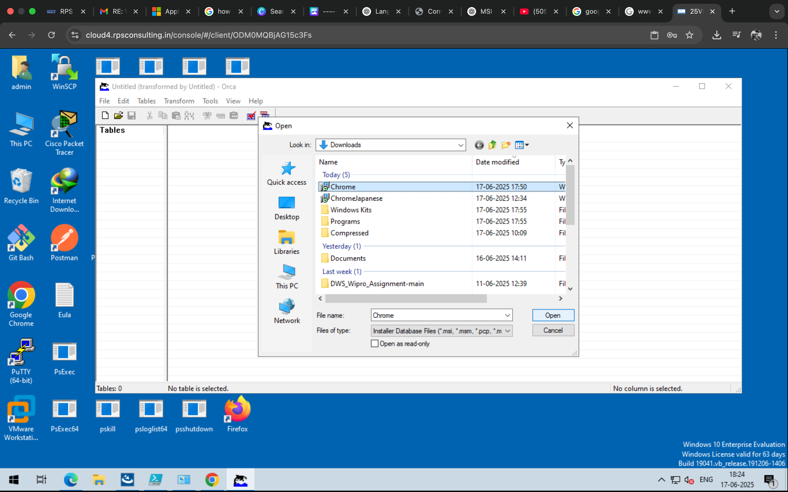
Introduction to Tools
Introduction to Tools
1. Orca (Microsoft):
Orca.exe: A Windows Installer package editor provided in the Windows SDK.
Used to view, edit, and generate MST files.
Allows table-level manipulation of MSI packages.
2. A .msi Package File:
.msi file which is to be transformed for Language Transformation.
2
2024 - RPS Consulting all rights reserved

Slide 6

Steps to Create MST Transforms for Localization
Install the required tools for localization.
Ensure you download and install Orca from Microsoft as part of the Windows SDK.
Launch Orca to access its features.
After installation, open Orca to begin creating MST transforms.
Understand the Orca dashboard and menu options.
Familiarize yourself with the menu bar for efficient navigation.
2
2024 - RPS Consulting all rights reserved

Slide 7
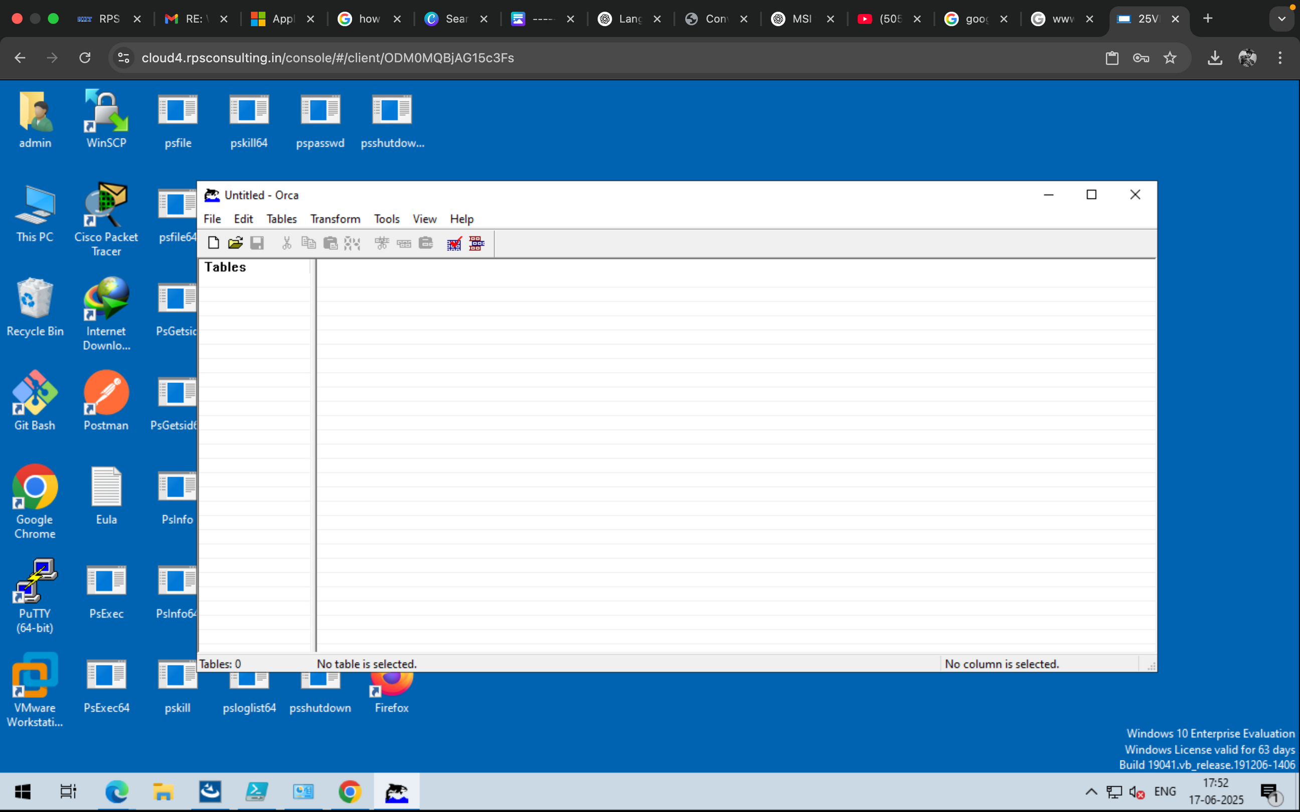
This is the basic Dashboard of ORCA
Orca is a Microsoft tool used to view and edit Windows Installer (.msi) files. It's part of the Windows SDK.
Menu Bar:
Contains the standard menus:
File > Edit > Tables > Transform > Tools > View > Help
2
2024 - RPS Consulting all rights reserved

Slide 8
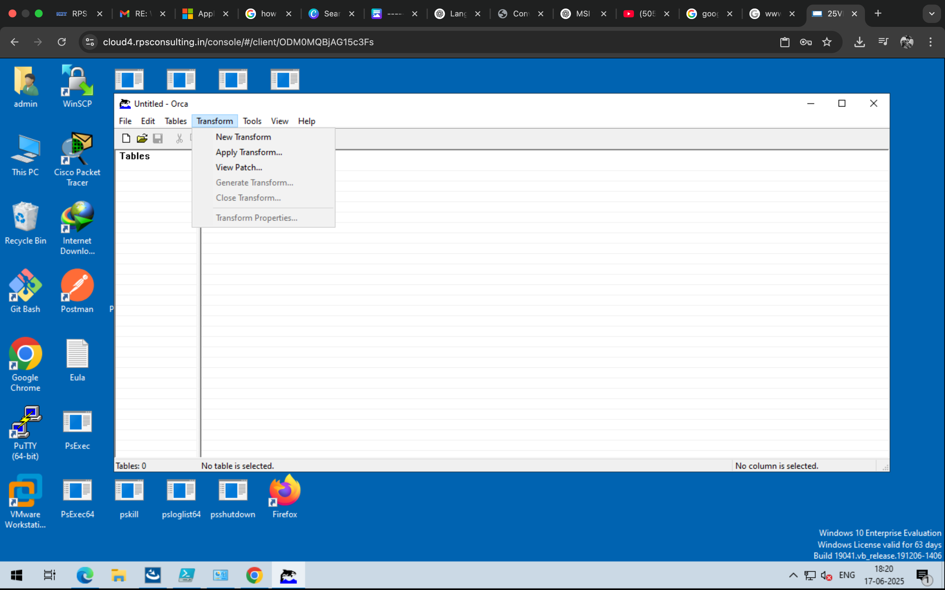
Create a New Transform
Go to Transform > New Transform.
This begins tracking the changes you make.
After Clicking on the NEW TRANSFORM from the TRANSFORM
We need to load the .msi package to Transform
2
2024 - RPS Consulting all rights reserved

Slide 9
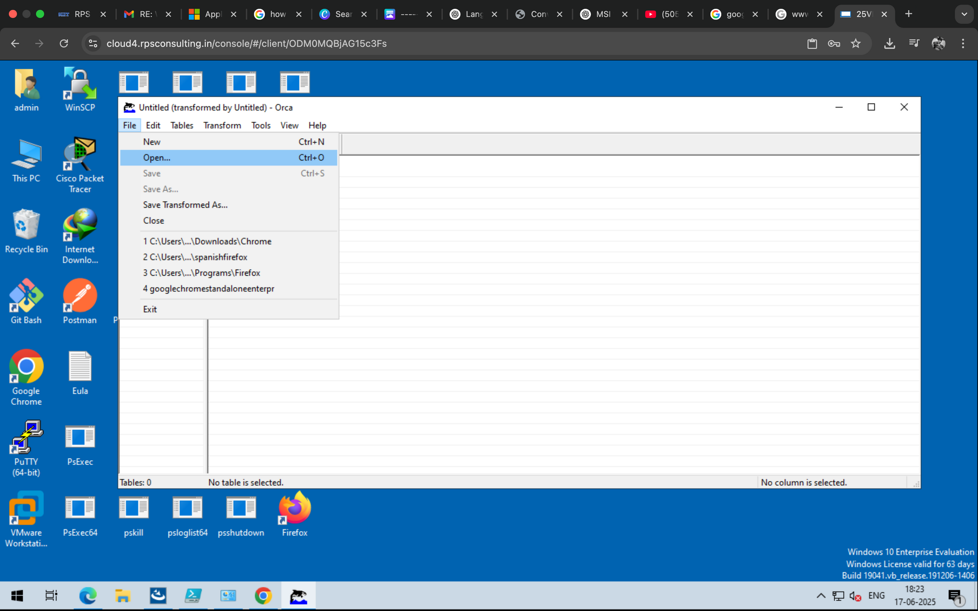
Load the msi Package in ORCA
From the Orca File Menu load the MSI package file into ORCA for Transformation
2
2024 - RPS Consulting all rights reserved

Slide 10

Choose the msi file and load it into the ORCA Dashboard
2
2024 - RPS Consulting all rights reserved

Slide 11
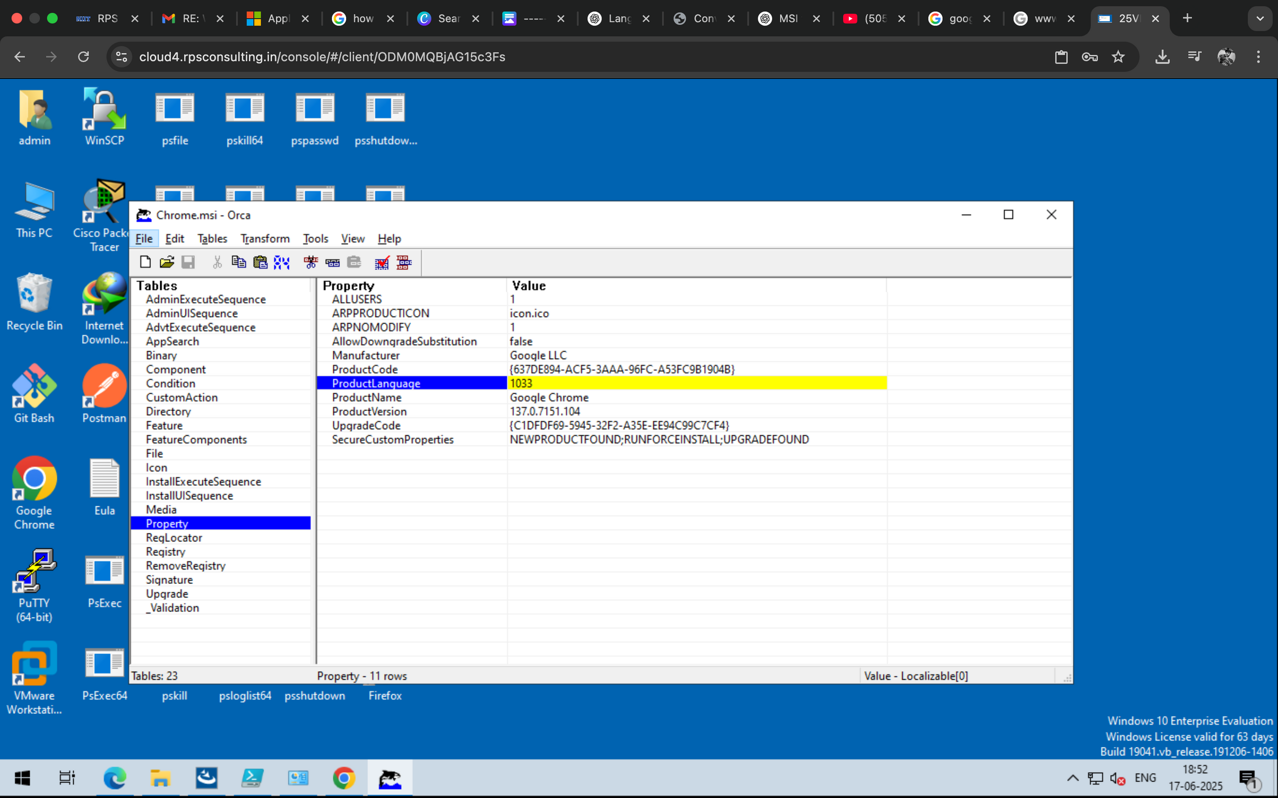
The Orca window is displaying the Property table of the Chrome.msi file.
Which then shows the Value assigned with the Properties
This view is typically used for:
Customizing MSI behavior before deployment (e.g., silent install, pre-configured settings).
Reading version, product codes, and language info for enterprise software deployment.
Modifying or troubleshooting MSI installs in a corporate or lab environment.
2
2024 - RPS Consulting all rights reserved

Slide 12
Creating Language Specific MST Transforms
In the Snapshot
In the Table section we navigate to the Property
Which Displays the Properties
Where we Edit or Change the Product Language
English (United States): 1033
French (France): 1036
German (Germany): 1031
Japanese: 1041
Spanish (Spain): 3082
2
2024 - RPS Consulting all rights reserved

Slide 13
Steps to create Language Transformation
Navigate to the Product Language Property
Check for the Language code
In this snapshot the code is 1033
The Language Code 1033 represnts English Language
2
2024 - RPS Consulting all rights reserved

Slide 14
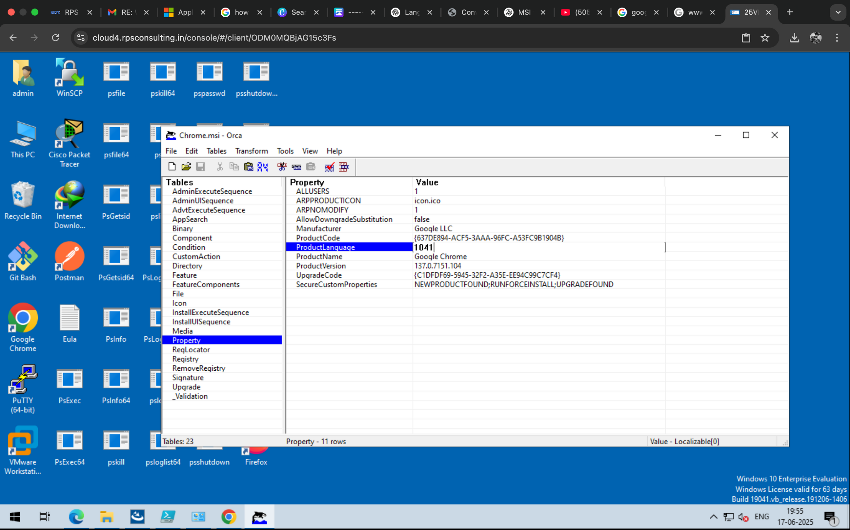
The ProductLanguage is changed now to 1041
The next step involves of Generating the Tranformation
When Clicked in Generate Transformation it Produces a .mst File which contains the Transformed Data
2
2024 - RPS Consulting all rights reserved

Slide 15
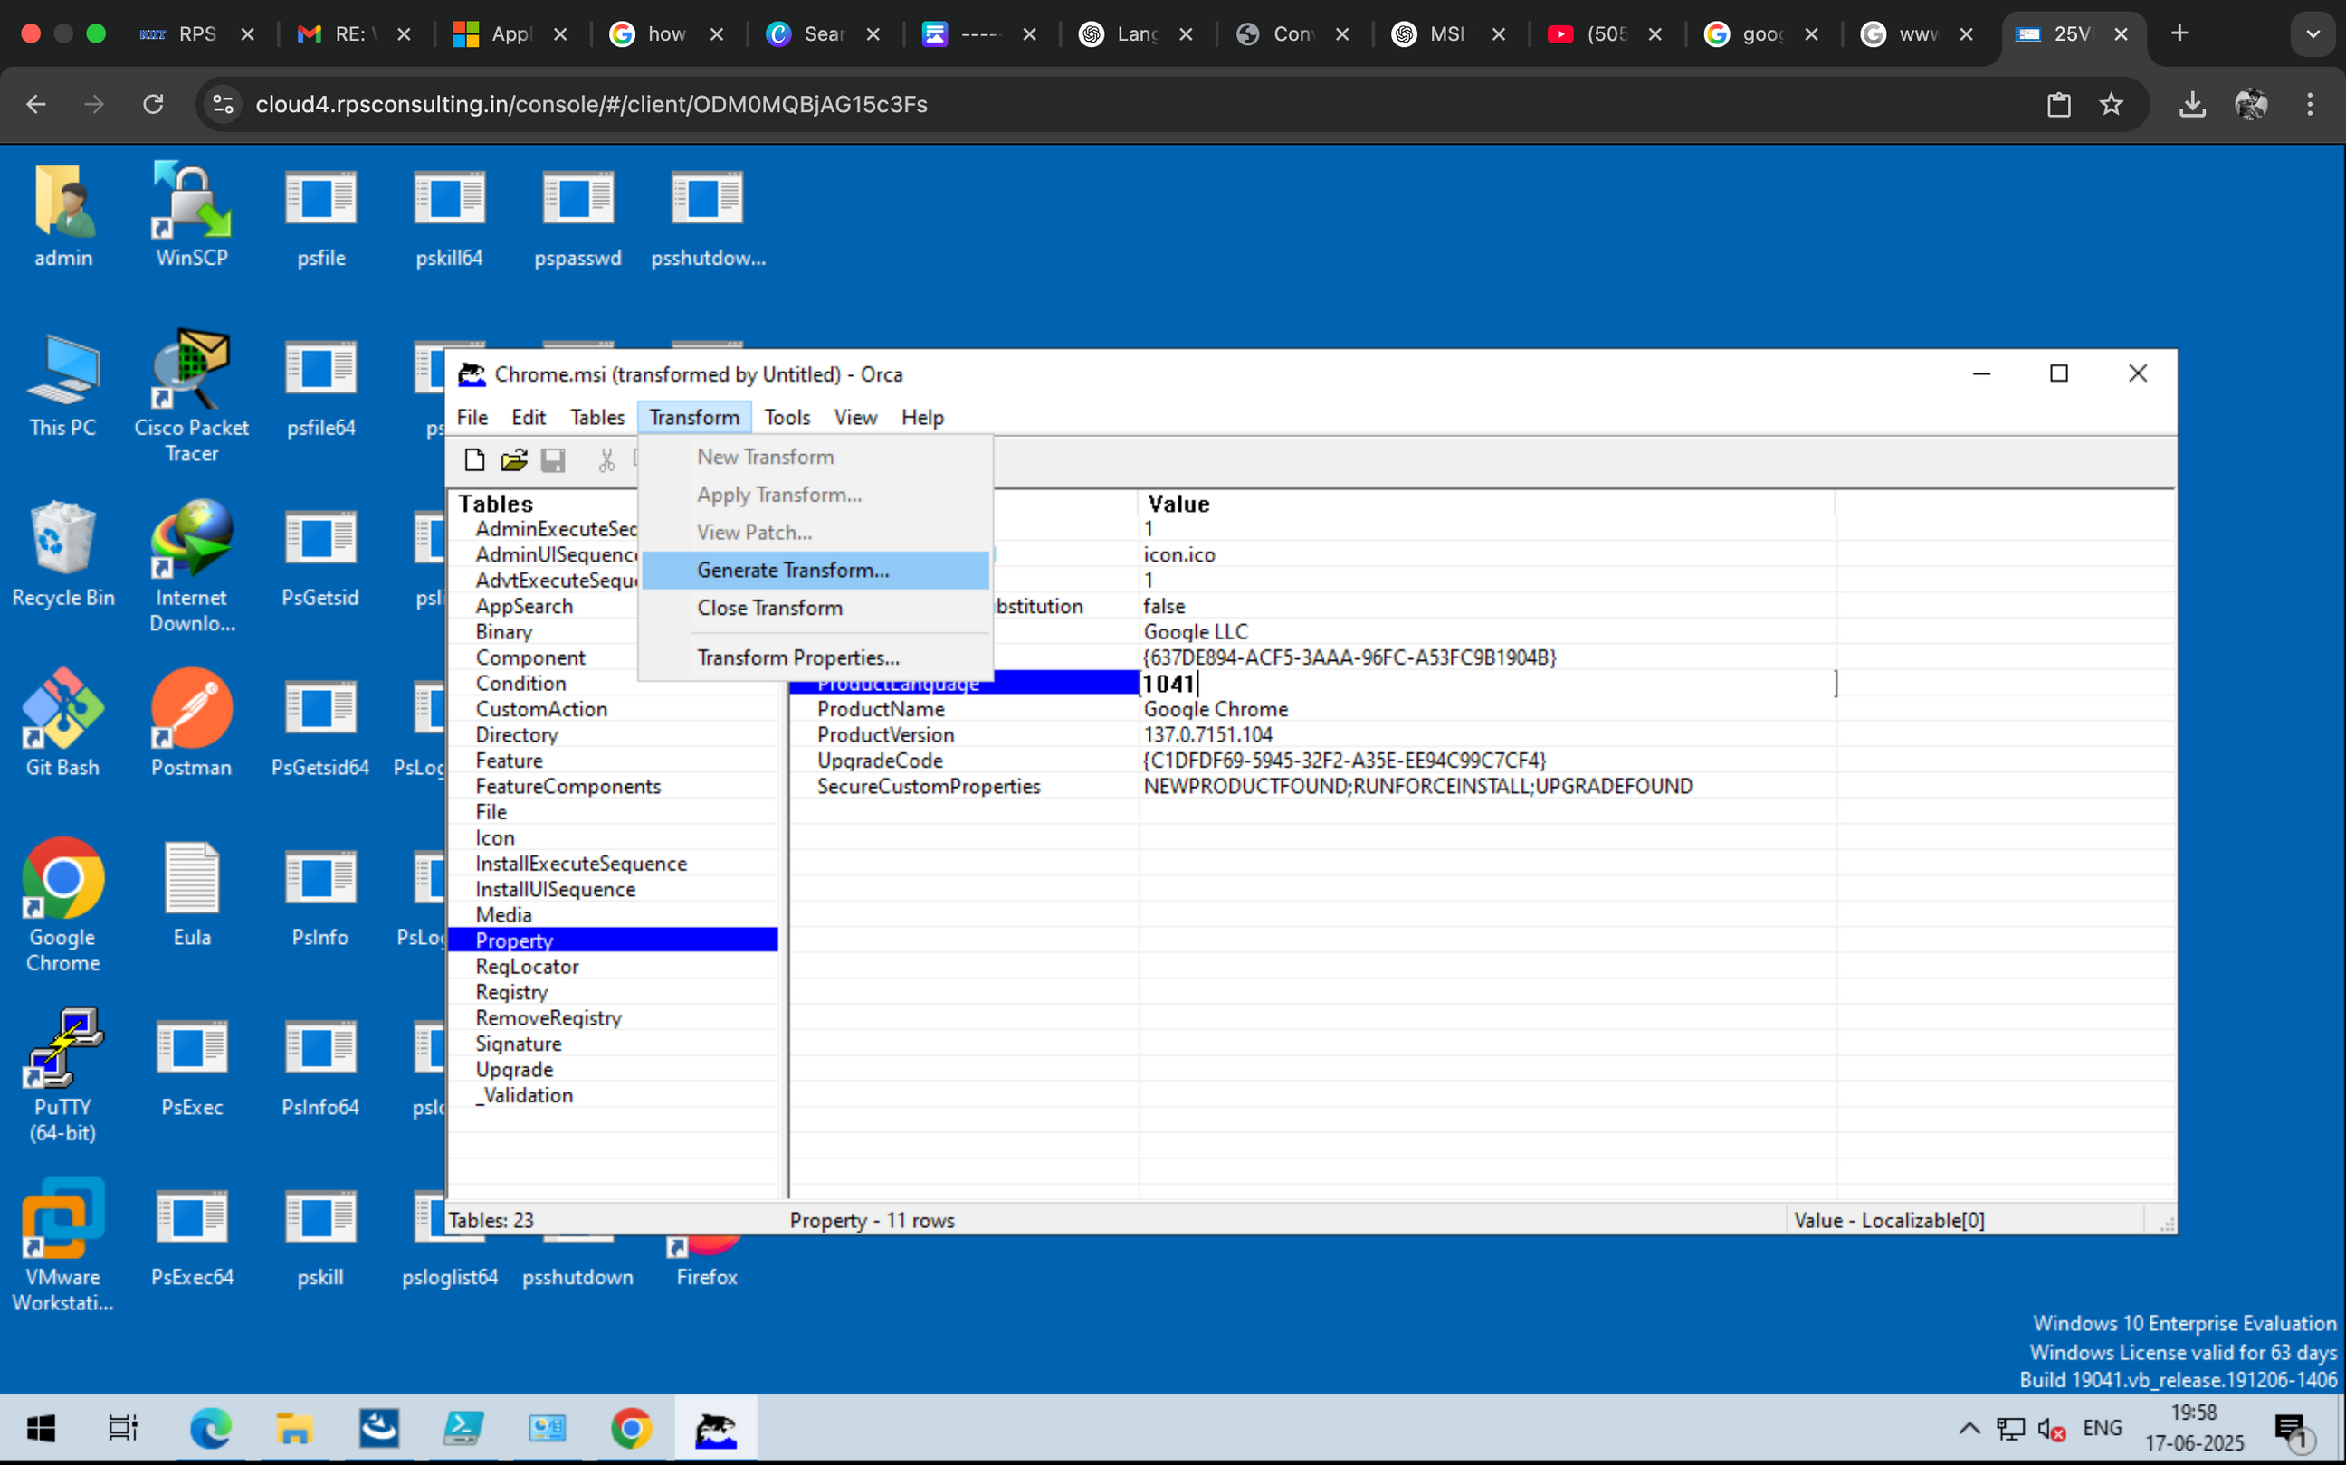
2
2024 - RPS Consulting all rights reserved

Slide 16
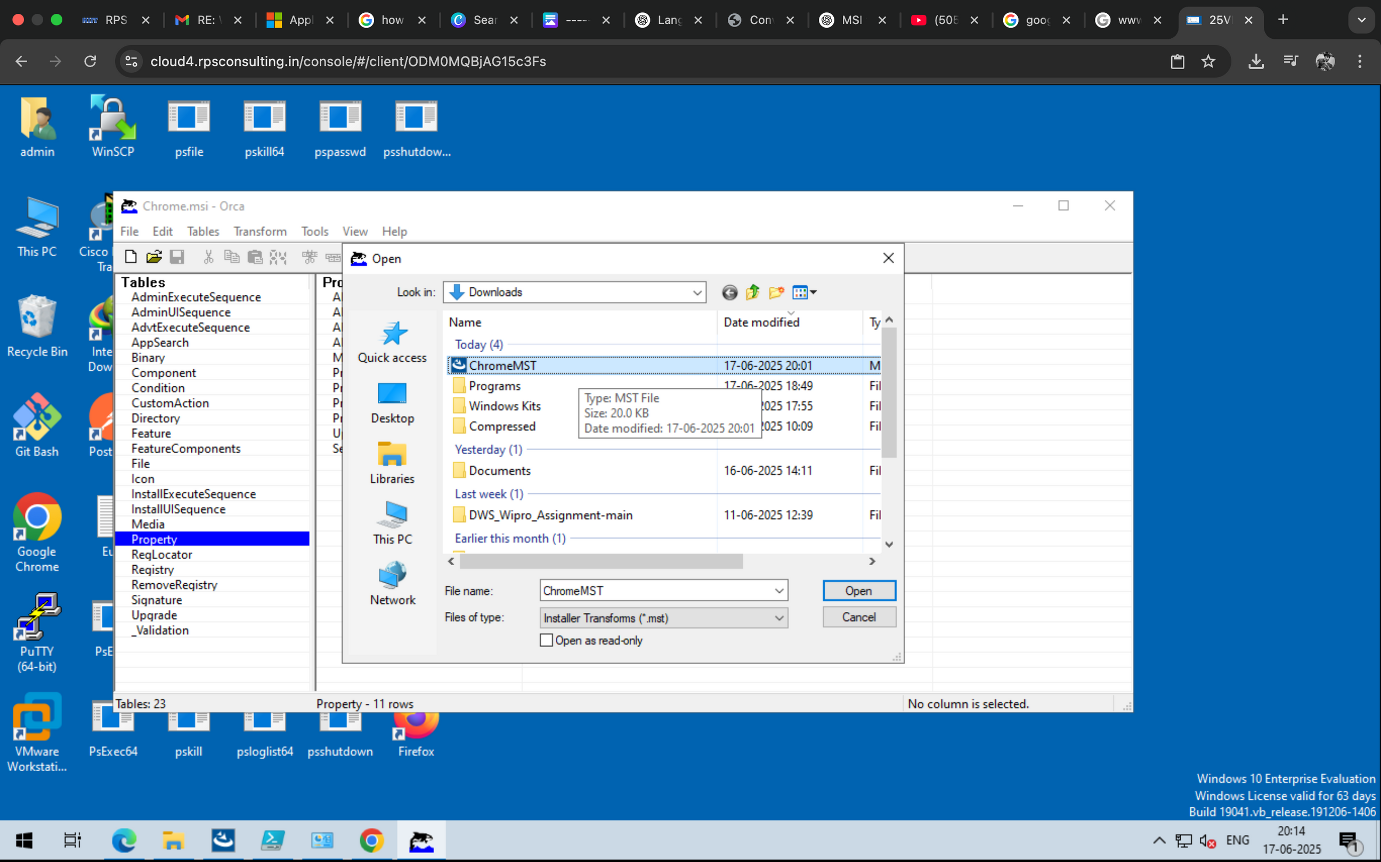
2
2024 - RPS Consulting all rights reserved

Slide 17
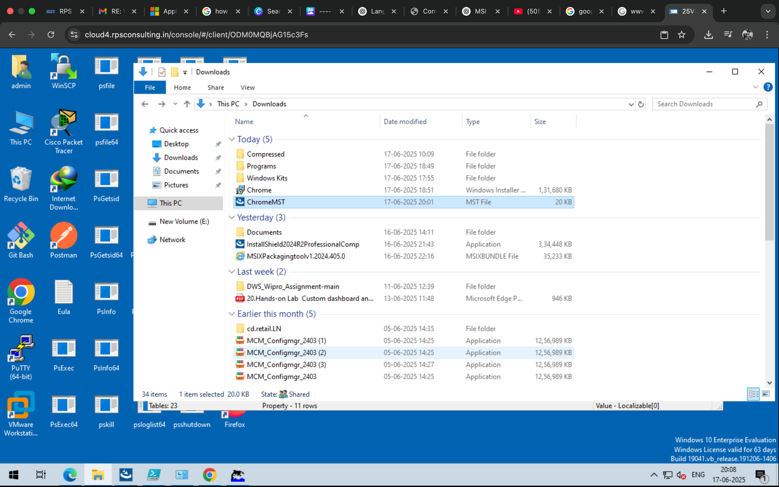
After committing the transform We have not got the Chrome.MST file which is saved in preferred location
As we see the MST file is generated and stored in the Location
Downloads\ChromeMST
2
2024 - RPS Consulting all rights reserved

Slide 18
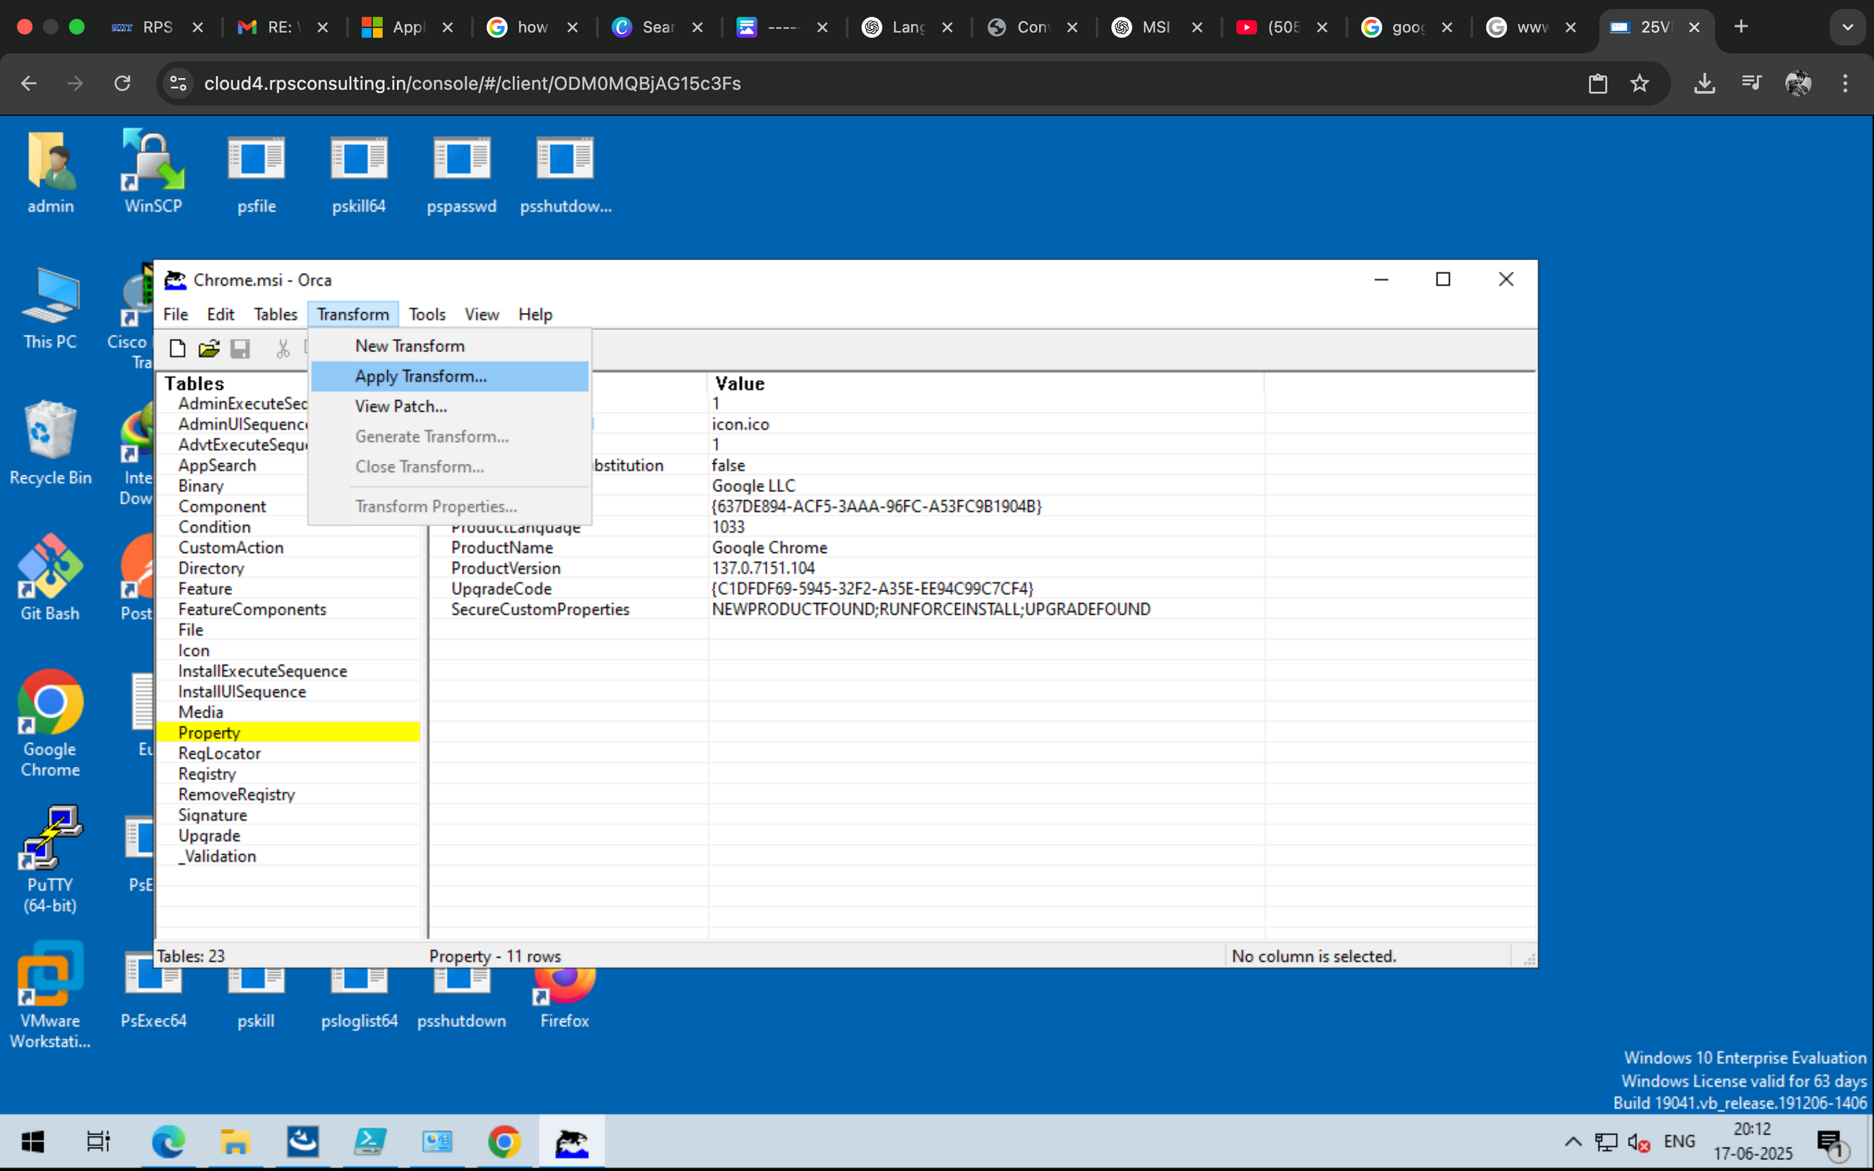
Now the Further steps involves of bundling the msi and mst package file
Now open the chrome.msi to apply Transformation to it
Navigate to the files > Open File > Choose the .msi package
Navigate to the Transformation Menu > APPLY TRANSFORM
2024 - RPS Consulting all rights reserved

Slide 19
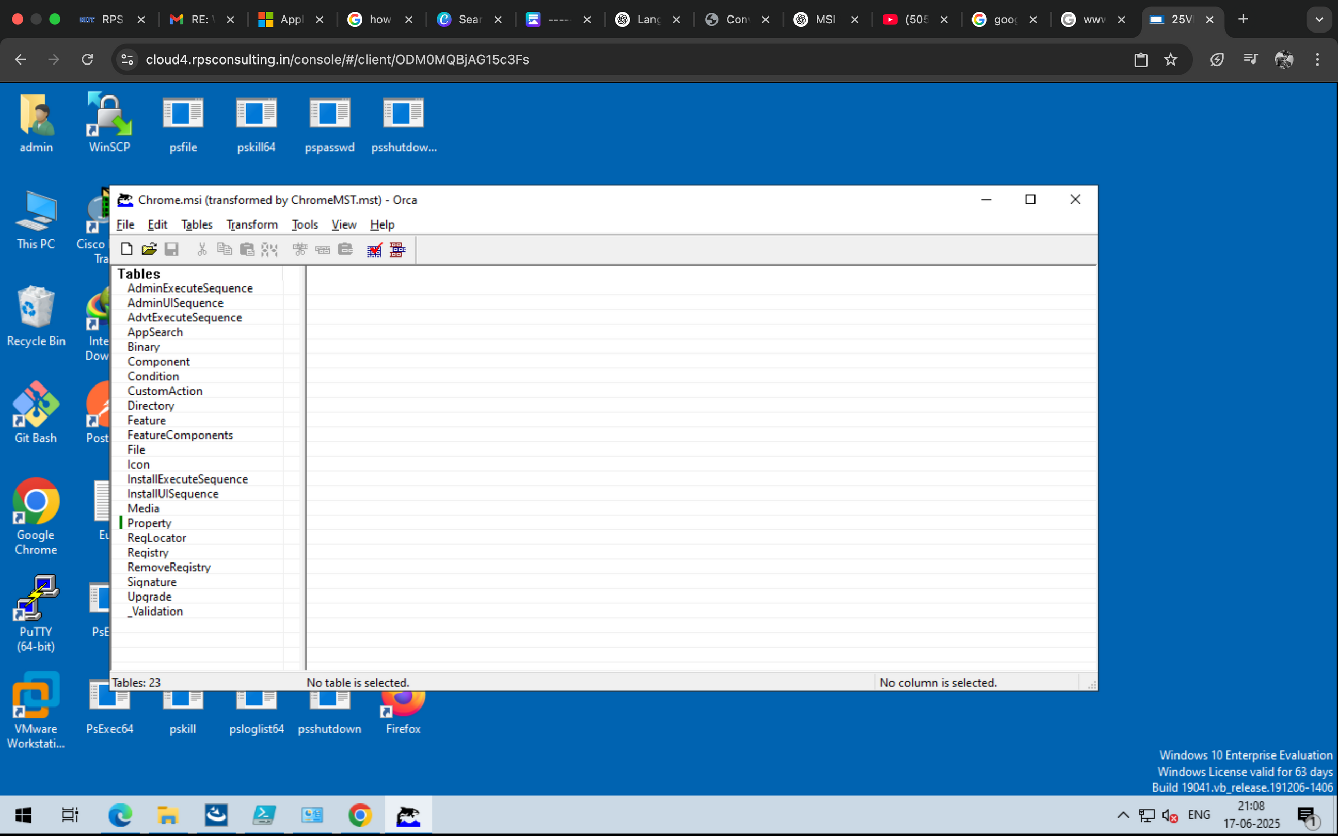
Choose the mst file which we created earlier named ChromeMST
When the file is selected it is Opened the ORCA Bundles the files And Shows the Transformed status as shown
2024 - RPS Consulting all rights reserved

Slide 20
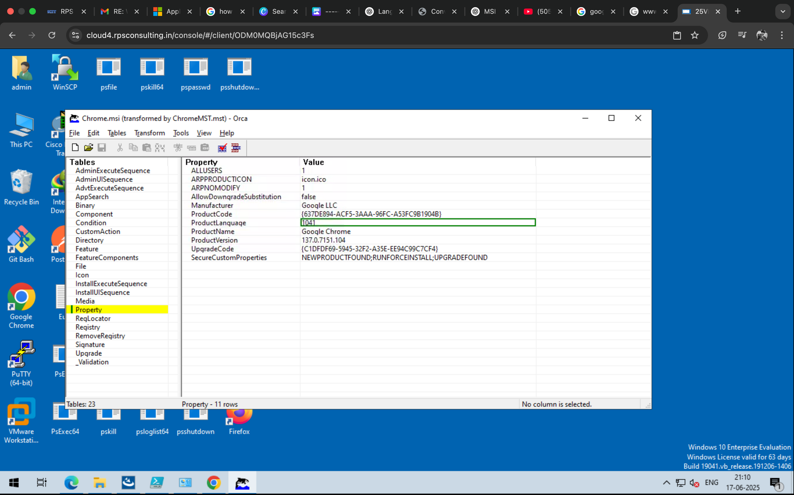
once Transformed the file is now ready to be saved as Transformation
We can now see the ProductLanguage is changed as of 1033 to 1041
Now once we know the ProductLanguage is Changed
We now head towards Saving the file
Hit the SAVE TRANSFORMED AS button from File Menu
2024 - RPS Consulting all rights reserved

Slide 21
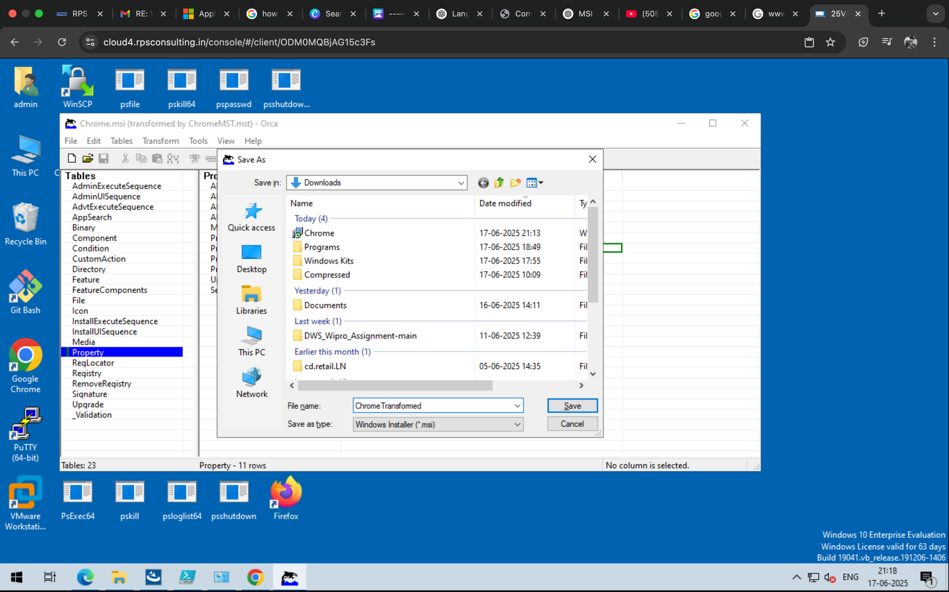
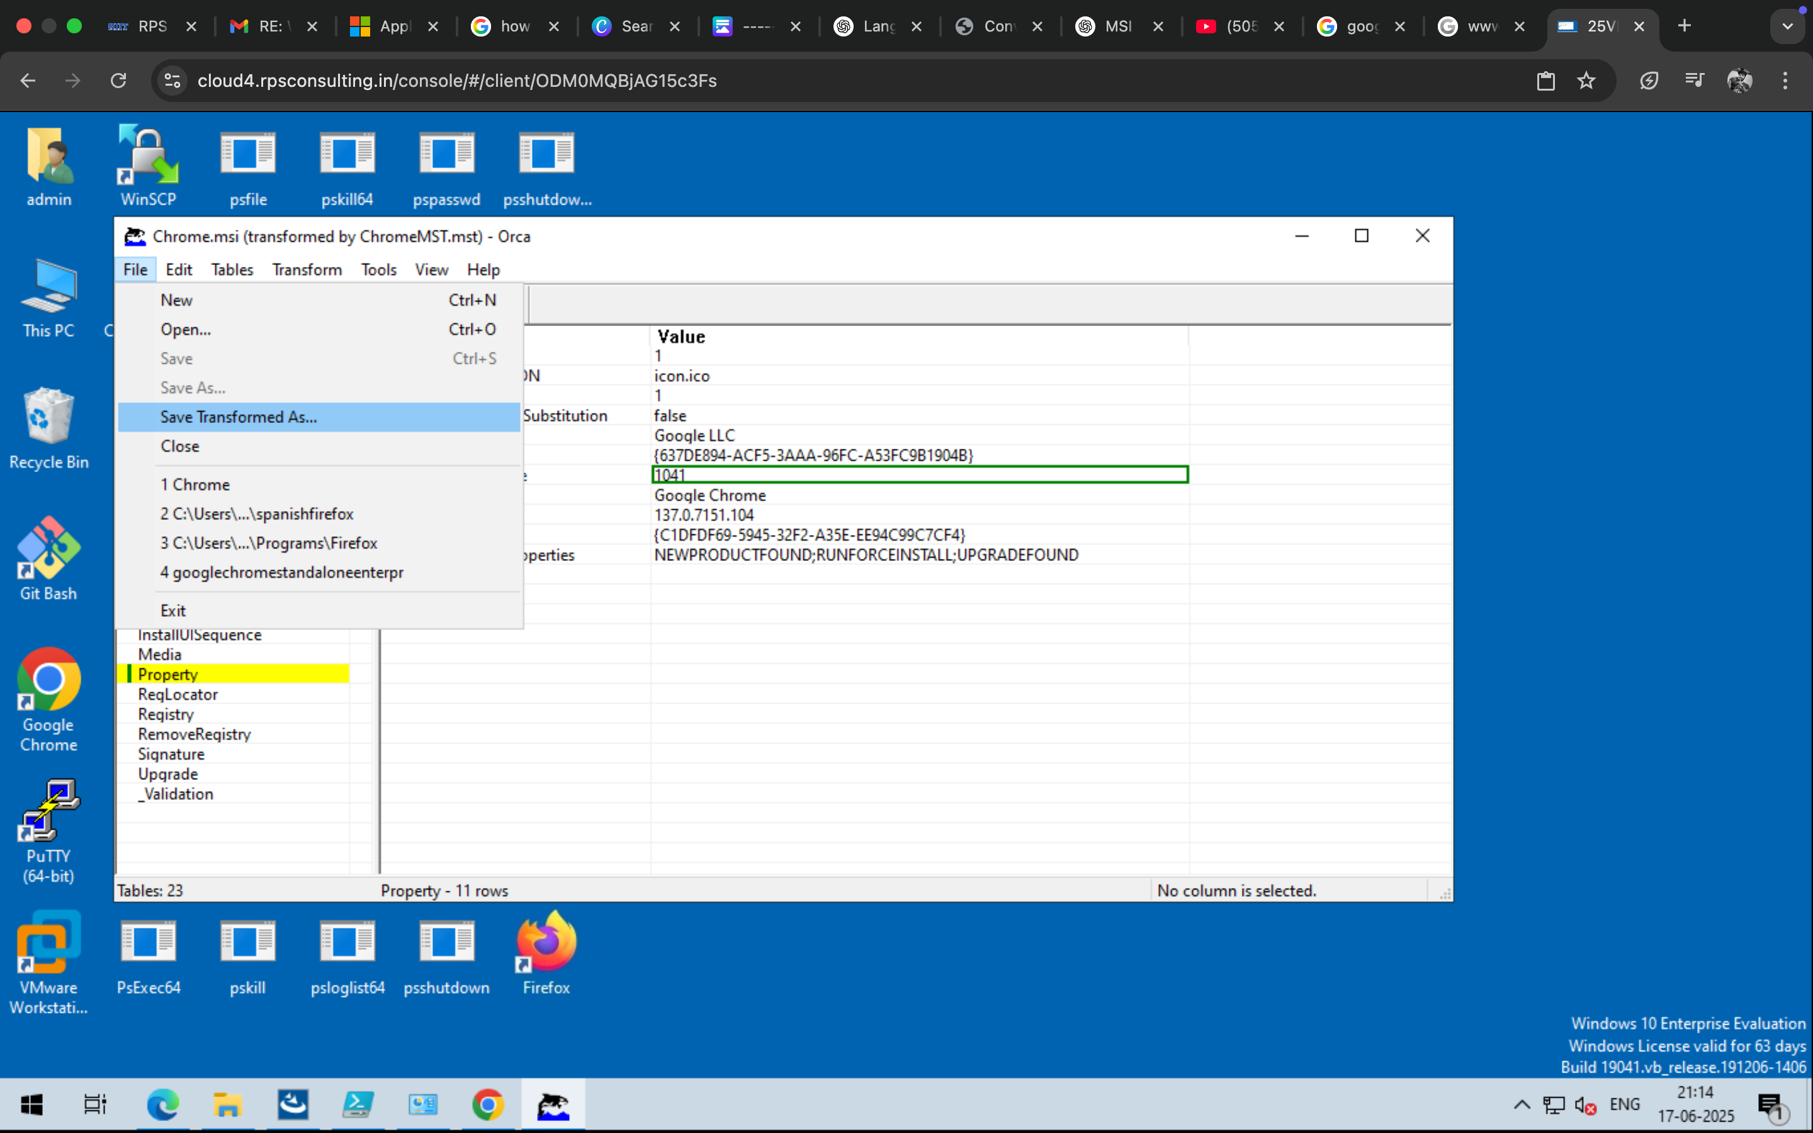
Save the Transformed package
2024 - RPS Consulting all rights reserved

Slide 22
Test Installation
Use msiexec to Apply MST During Installation
The msiexec command-line tool is used to run MSI installations on Windows. You use it to apply your MST file during the installation like this:
bash
CopyEdit
msiexec /i Chrome.msi TRANSFORMS=ChromeTransformed.mst
On successful Transformation of the file we have got the Language Transformed Application
2024 - RPS Consulting all rights reserved

Slide 23
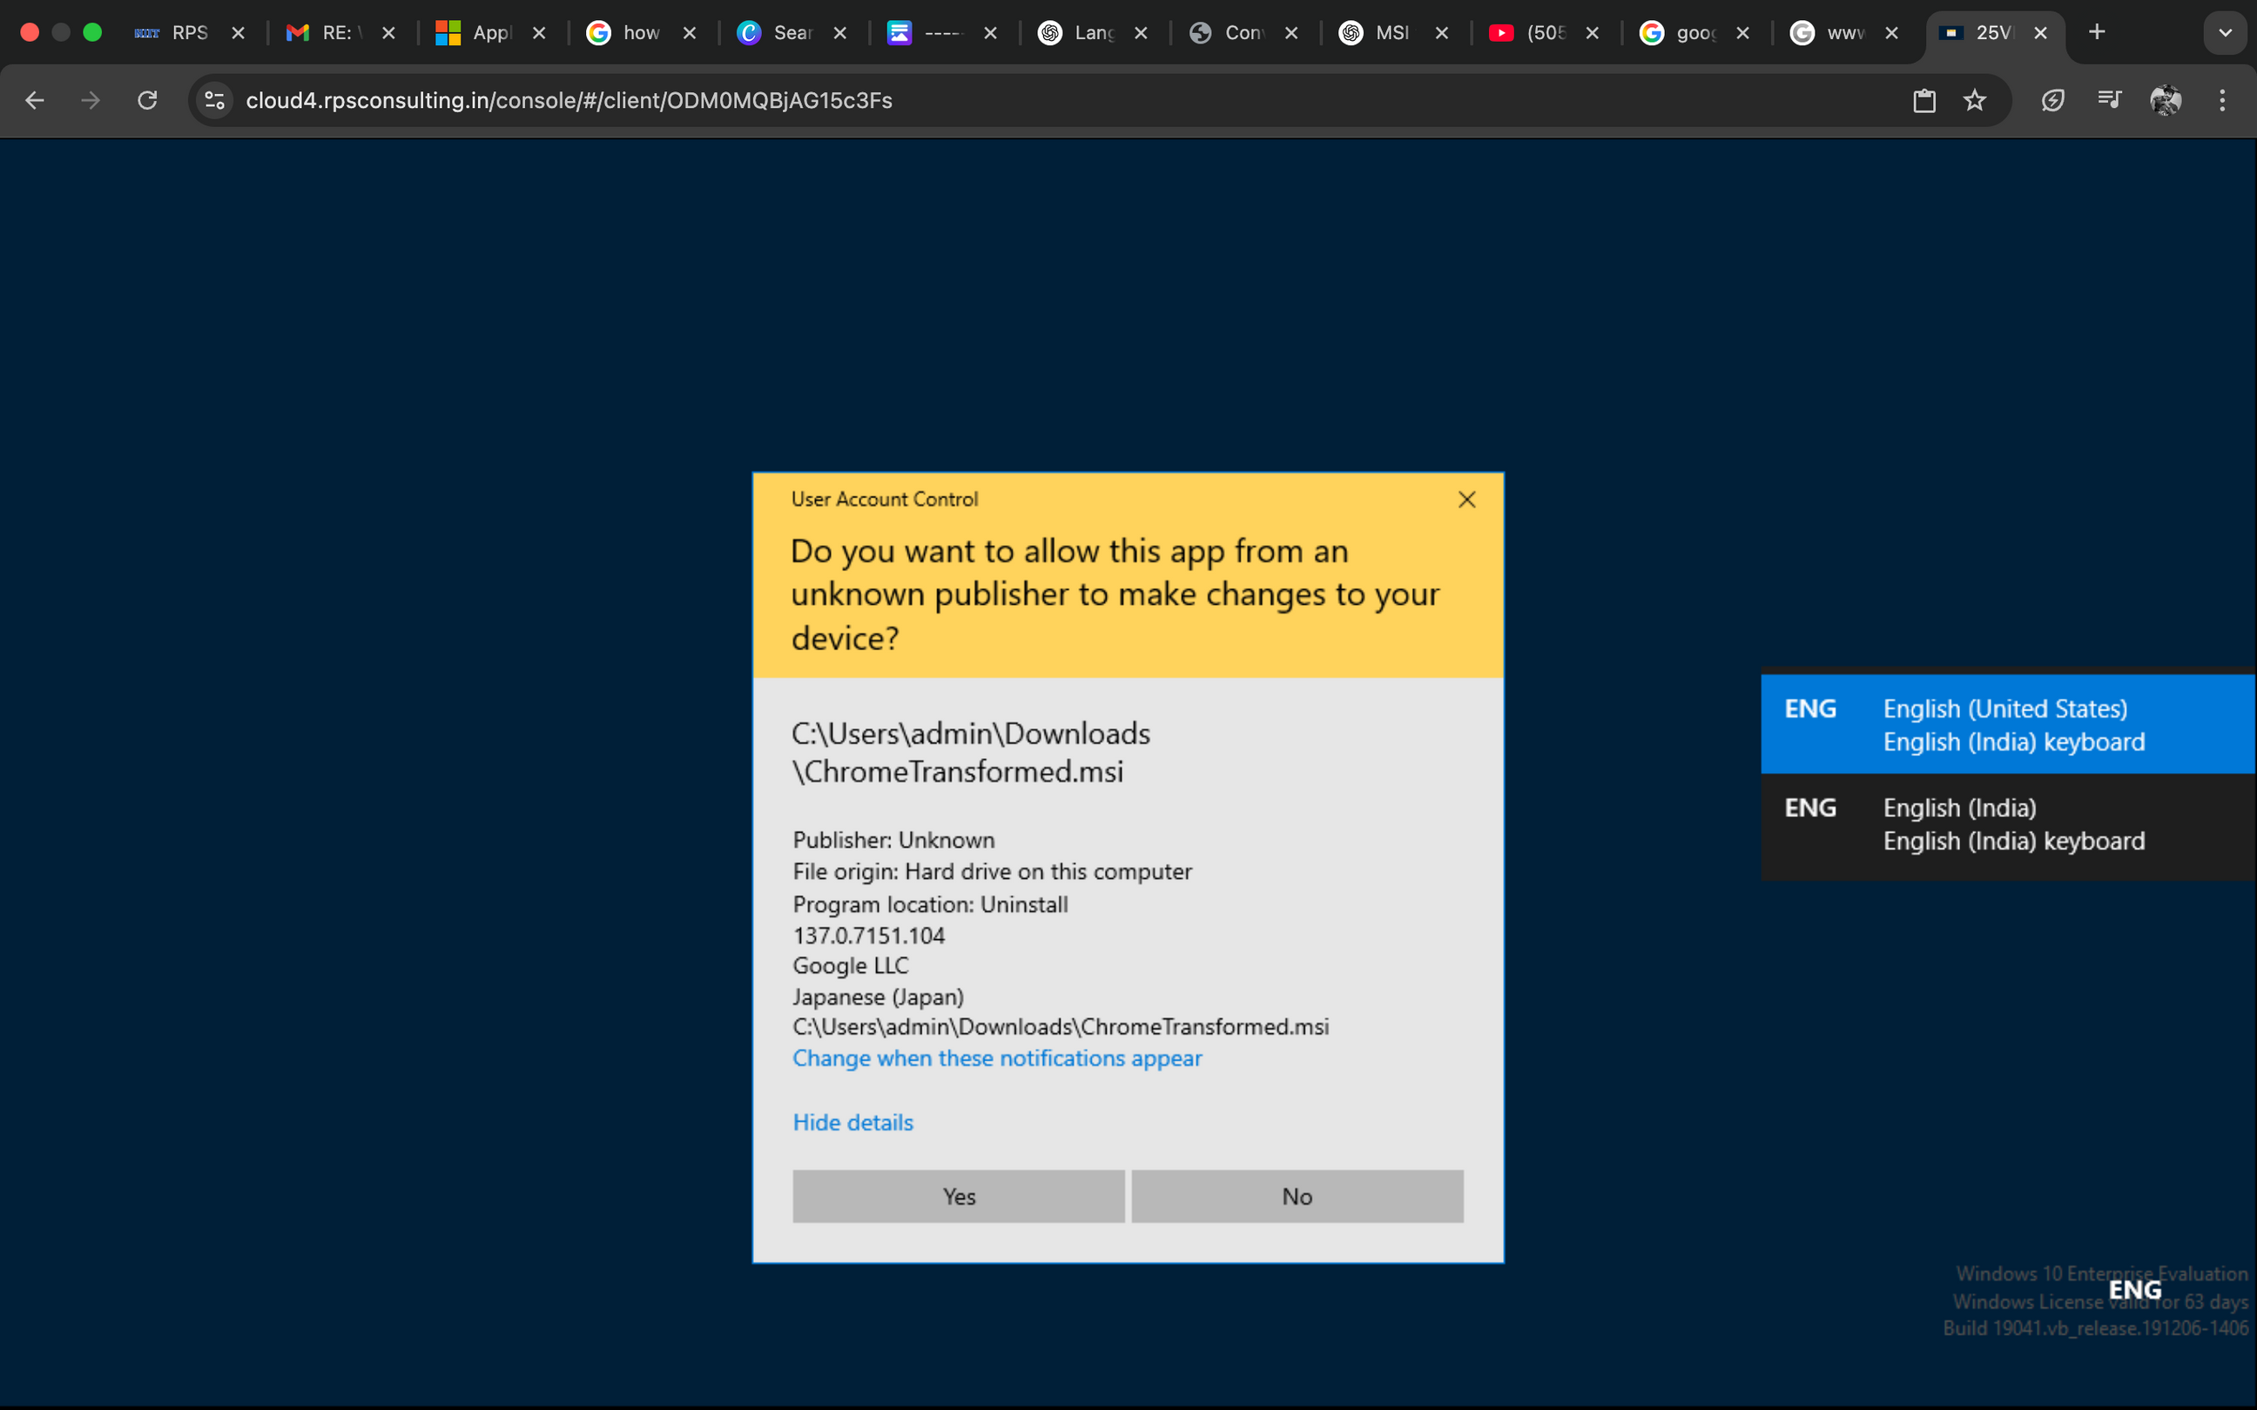
Results
2024 - RPS Consulting all rights reserved

Slide 24

Thank You!!!
2024 - RPS Consulting all rights reserved

